Slide 1
Unit 6: Fire Safety and Utility Controls
CERT Basic Training

Slide 2
Review
What are some of steps you can take to personally reduce stress?
What are CERT rules for administering medicines?
When conducting a Head to Toe assessment, what are some important rules?
Notes:
1) Eat, sleep, talk, etc. 2) We do not EXCEPT to assist survivor with own epipen 3) Conduct on all survivors even those who appear fine, Verbal (explain, ask questions and listen), Hands-on. Can remove clothes to expose an injury

Slide 3
Unit 6 Objectives
Explain the role CERTs play in fire safety and response, including the CERT size-up process and minimum safety precautions
Extinguish a small fire using a fire extinguisher
Identify and reduce potential fire, utility, and other hazards at home and in the community
Identify hazardous materials
PM 6-1
CERT Basic Training Unit 6: Fire Safety and Utility Controls
6-1

Slide 4
Role of CERTs
CERTs play very important role in fire safety by:
  Acting as immediate responders until professionals arrive
    Extinguishing small fires
    Preventing additional fires by removing fuel sources
    Shutting off utilities
    Assisting with evacuations, when necessary
PM 6-1
CERT Basic Training Unit 6: Fire Safety and Utility Controls
6-2

Slide 5
CERT Priorities
Rescuer safety is number one priority
  Always work with a buddy
  Always wear safety equipment
  CERT Goal:
  Do the greatest good for the greatest number
PM 6-1
CERT Basic Training Unit 6: Fire Safety and Utility Controls
6-3

Slide 6
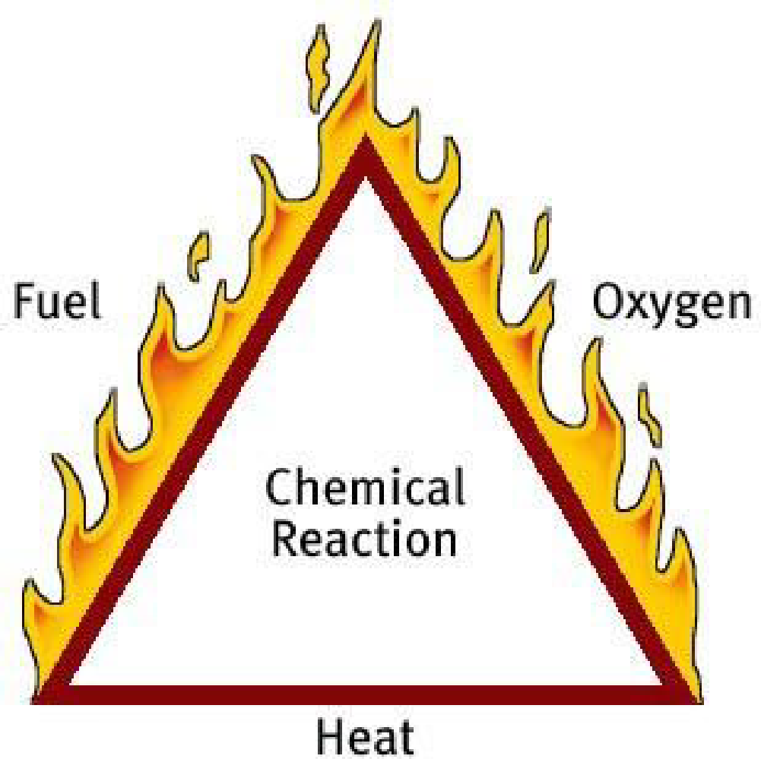
The Fire Triangle
PM 6-3
CERT Basic Training Unit 6: Fire Safety and Utility Controls
6-4

Slide 7
Classes of Fire
Class A: Ordinary combustibles
Class B: Flammable and combustible liquids
Class C: Energized electrical equipment
Class D: Combustible metals
Class K: Cooking oils
PM 6-3
CERT Basic Training Unit 6: Fire Safety and Utility Controls
6-5
Notes:
A - newspaper, drapes, wood, tires, some plastics.
B - oils & gasoline, lighter fluid, kerosene. Vapor burns
C - wires, motors, burning smell you can't see. Power off - becomes class A
D - aluminum, magnesium, titanium
***Important to identify fuel type
?s

Slide 8
CERT Fire Size-up
Helps CERT volunteers decide:
  Whether to attempt to suppress a fire
  A plan of action
Answers these questions:
  Do my buddy and I have the right equipment?
  Are there other hazards?
  Is the building structurally damaged?
  Can my buddy and I escape?
  Can my buddy and I fight the fire safely?
  Remember: The safety of individual CERT volunteers is always the top priority
PM 6-4
CERT Basic Training Unit 6: Fire Safety and Utility Controls
6-6
Notes:
Impacts - time of week, weather, structure types (shed, residential, commercial)
construction type

Slide 9
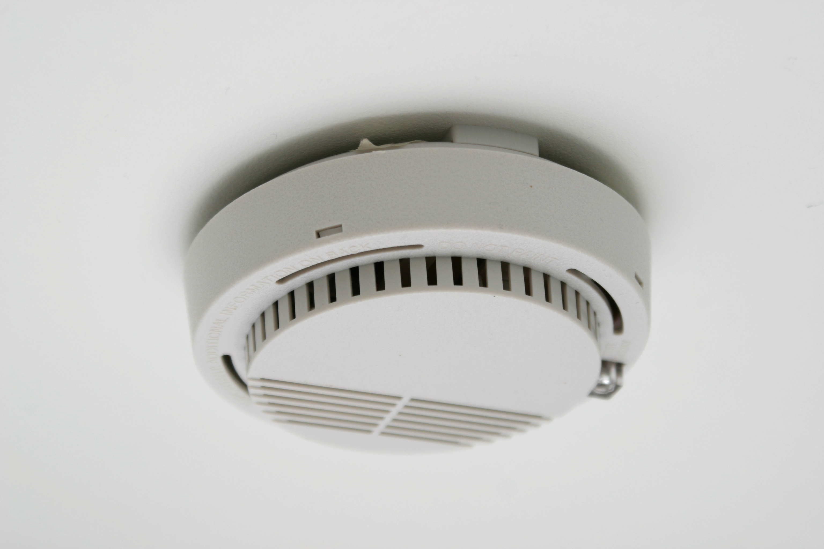
Firefighting Resources
Local fire department
Fire alarm system
Sprinkler systems
Portable fire extinguishers
Interior wet standpipes
PM 6-7
CERT Basic Training Unit 6: Fire Safety and Utility Controls
6-7

Slide 10
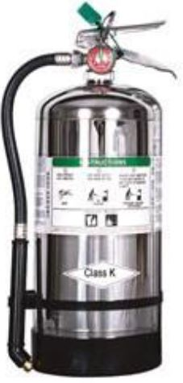
Fire Extinguishers
Use on small fires (never more than one
extinguisher attempt)
Types of extinguishers
  Water (type A fire)
  Dry chemical (type A, B & C)
  Carbon dioxide (type B & C)
  Specialized
PM 6-7
CERT Basic Training Unit 6: Fire Safety and Utility Controls
6-8
Notes:
A - can be Water - removes heat
Foam - removes air & heat
Dry chemical - breaks the chain reaction
B - Foam (not water)
ABC - Best for homes
NO WATER on stove fire

Slide 11
Extinguisher Rating/Labeling
Labels show types of fires for which that extinguisher is used
  Class A fire ratings: 1A to 40A
  Class B fire ratings: 1B to 640B
Higher number on label = greater amount of extinguishing agent
PM 6-8
CERT Basic Training Unit 6: Fire Safety and Utility Controls
6-9

Slide 12
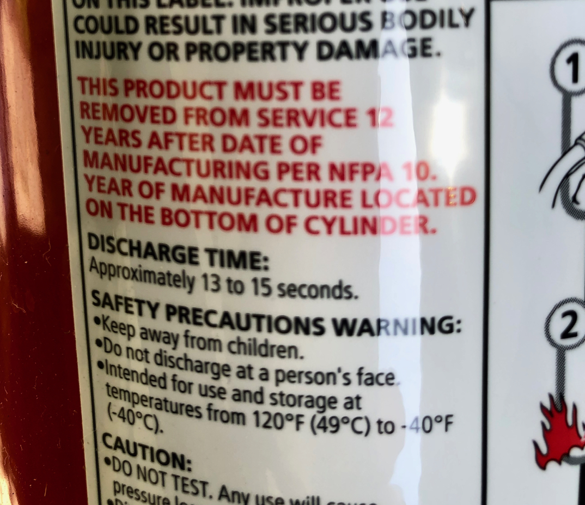
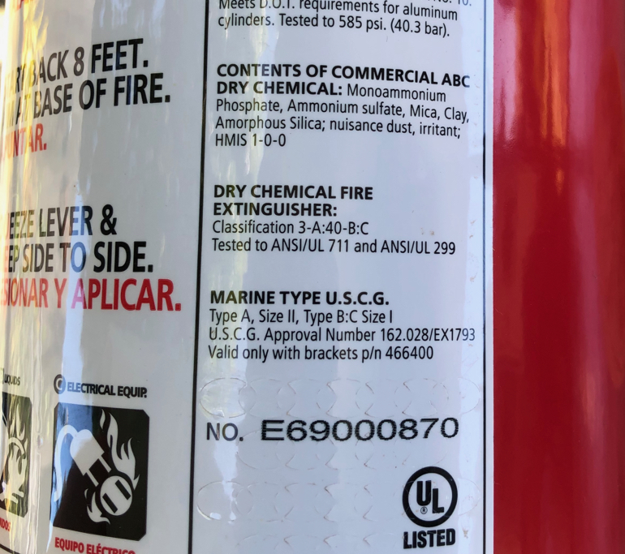
Sample Label
PM 6-8
CERT Basic Training Unit 6: Fire Safety and Utility Controls
6-10

Slide 13
Remember the P.A.S.S. Word
Size-up: is fire small enough?
Does team have the right type?
Test extinguisher after pulling pin
Aim nozzle at base of fire (not flames)
PM 6-11
CERT Basic Training Unit 6: Fire Safety and Utility Controls
6-11

Slide 14
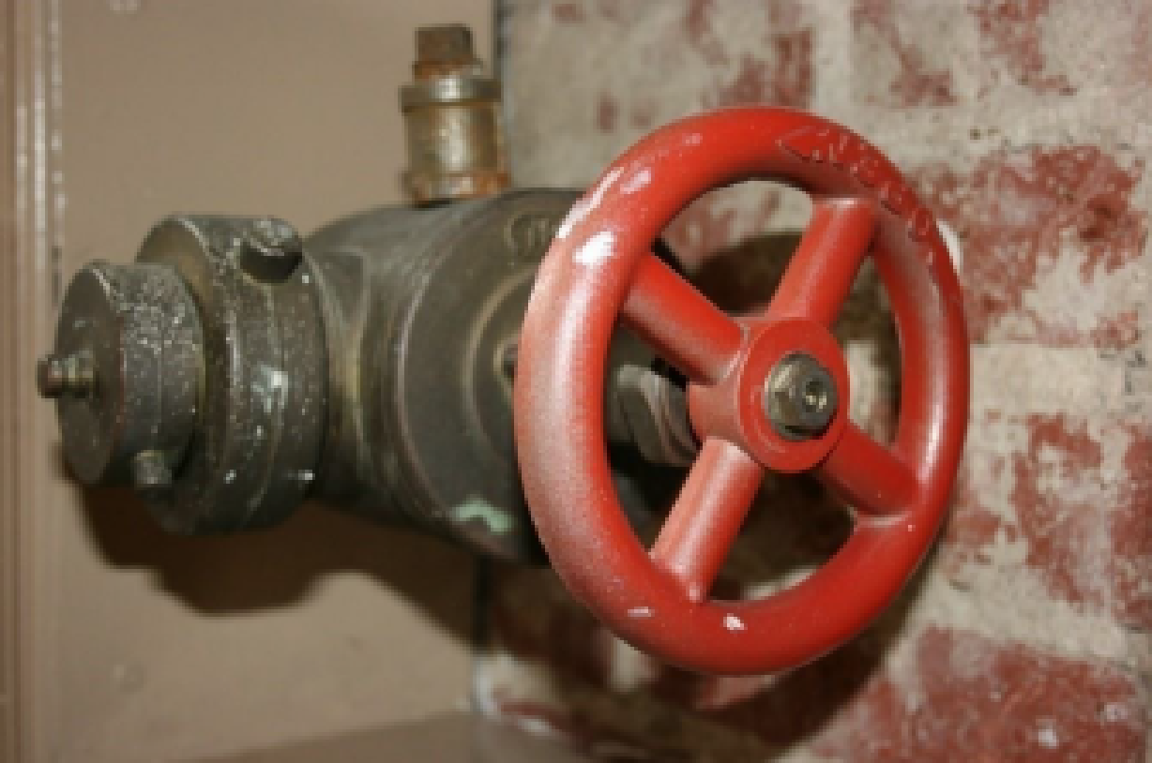
Interior Wet Standpipes
Usually found in commercial buildings or apartments
CERT volunteers should not operate
PM 6-11
CERT Basic Training Unit 6: Fire Safety and Utility Controls
6-12

Slide 15
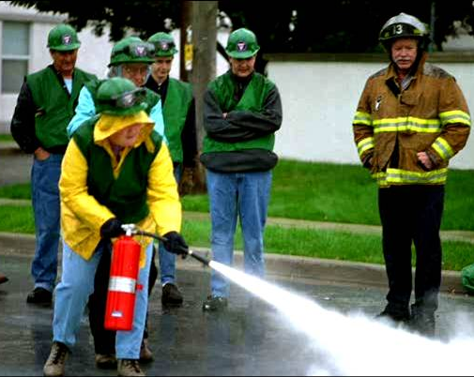
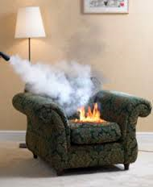
Fire Suppression Safety
Always fight fire with a buddy
Feel door with back of hand from bottom up (enter only if cool)
Get down low before entering (heat, smoke, & gases are up high)
Always locate two exits
If uncomfortable due to heat or smoke, GET OUT!
PM 6-12
CERT Basic Training Unit 6: Fire Safety and Utility Controls
6-14
Notes:
Next slide is video. Will play on your click

Slide 16
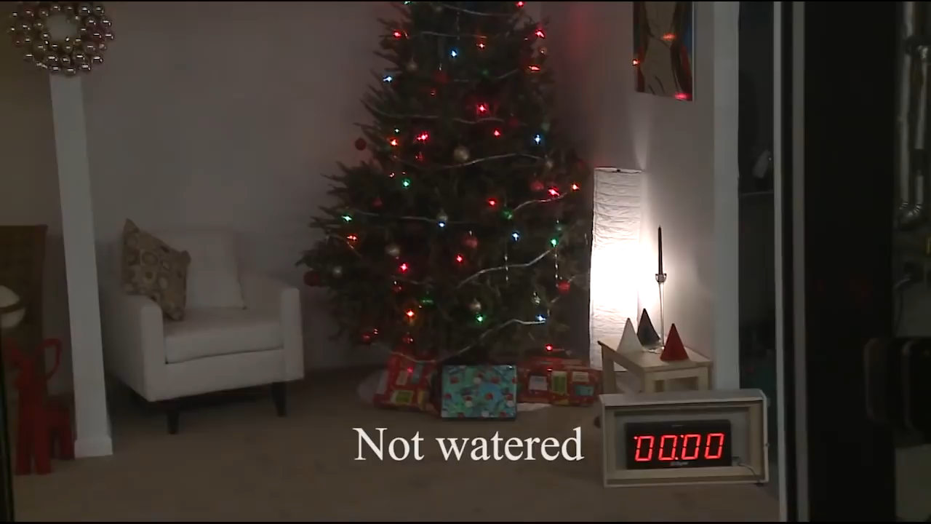
Fire Suppression Safety
CERT Basic Training Unit 6: Fire Safety and Utility Controls
6-13
Notes:
Fire prevention - Quesions?

Slide 17
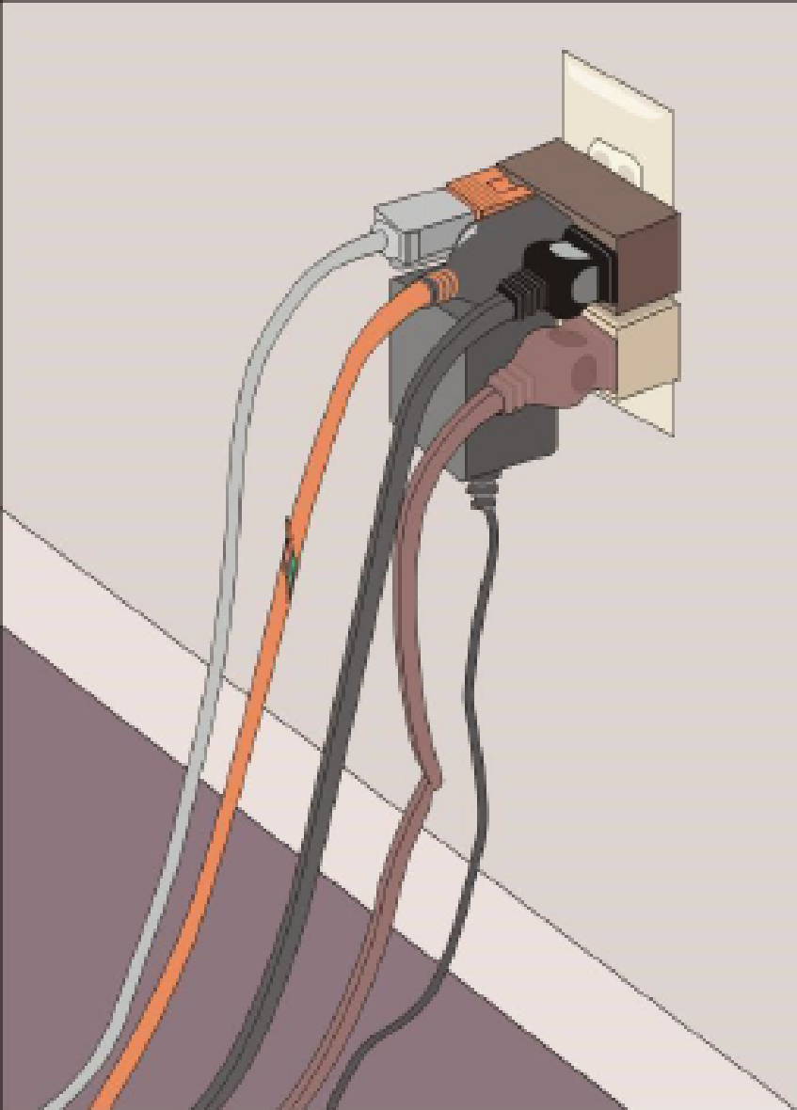
Reducing Electrical Hazards
Avoid the “electrical octopus”
Don’t run cords under carpets
Check for and replace broken or frayed cords
Maintain appliances
PM 6-14
CERT Basic Training Unit 6: Fire Safety and Utility Controls
6-15

Slide 18
Electrical Emergencies
Know where power shutoffs are
  Appliances
  Circuit breakers
  Fuses
Post shutoff directions next to all utilities
Know procedures for turning power back on after the fire
PM 6-14
CERT Basic Training Unit 6: Fire Safety and Utility Controls
6-16

Slide 19
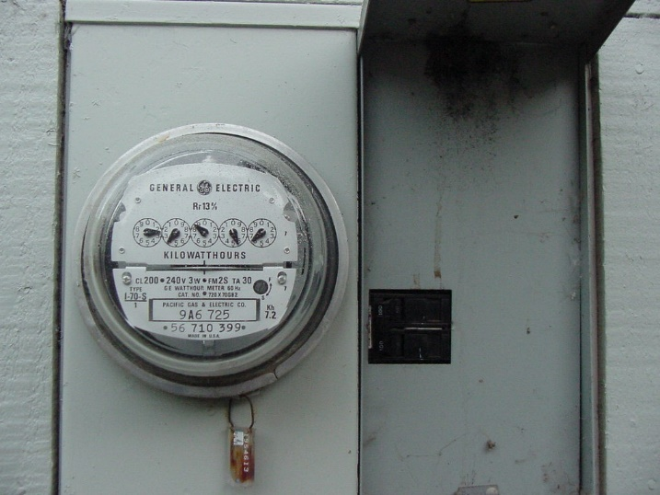
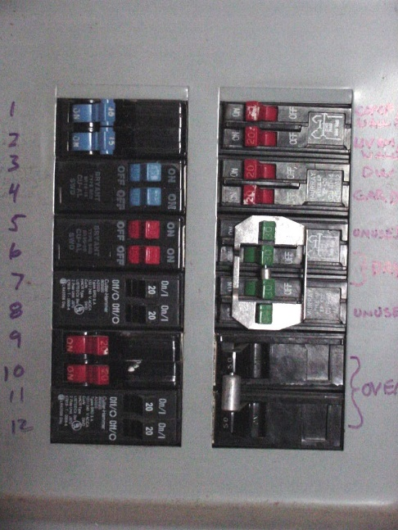
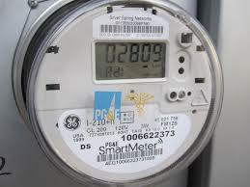
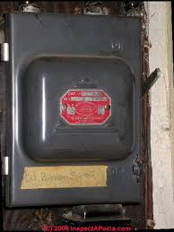
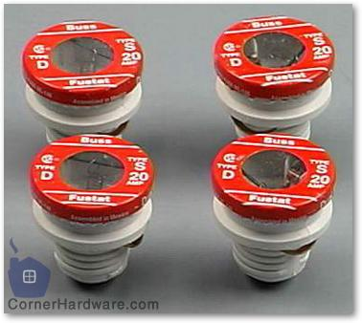
Shutoff Procedures
House main panel switch
Sub panel for individual circuits
Circuit breaker or fuse
Traditional or “Smart” meters switch the same
PM 6-14
CERT Basic Training Unit 6: Fire Safety and Utility Controls
6-17

Slide 20
When to Shut off Electricity
  Building collapse or major structural damage
  Arcing or smoke seen
  Smell of burning materials
  Blackened area around switches and plugs
  Loss of power accompanied by burning smell
PM 6-15
CERT Basic Training Unit 6: Fire Safety and Utility Controls
6-18
Notes:
Review order – individual circuits then main. Reverse to turn back on

Slide 21
Natural Gas/Propane Hazards
Asphyxiant
  Displaces oxygen in the body
  Propane is heavier than air (sinks)
Explosive
  Can readily ignite under the right conditions
Propane is shipped and stored in pressure tanks as liquid with shutoff valve
PM 6-15
CERT Basic Training Unit 6: Fire Safety and Utility Controls
6-18
Notes:
San Bruno image

Slide 22
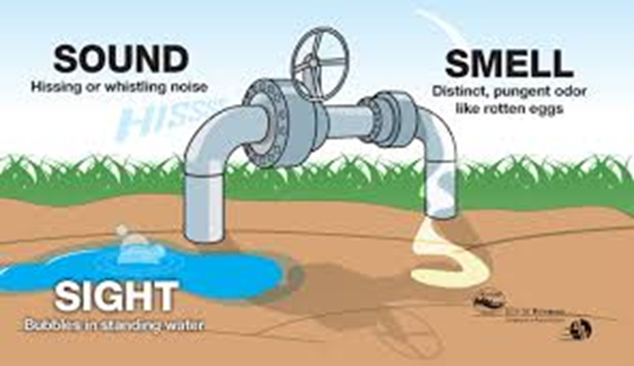
Natural Gas Hazard Awareness
Install natural gas detector
Install carbon monoxide detector in home
Test batteries for natural gas and carbon monoxide detectors every month
  Change batteries every six months
Locate and label gas shutoffs
  Have proper non-sparking tool
PM 6-15
CERT Basic Training Unit 6: Fire Safety and Utility Controls
6-19

Slide 23
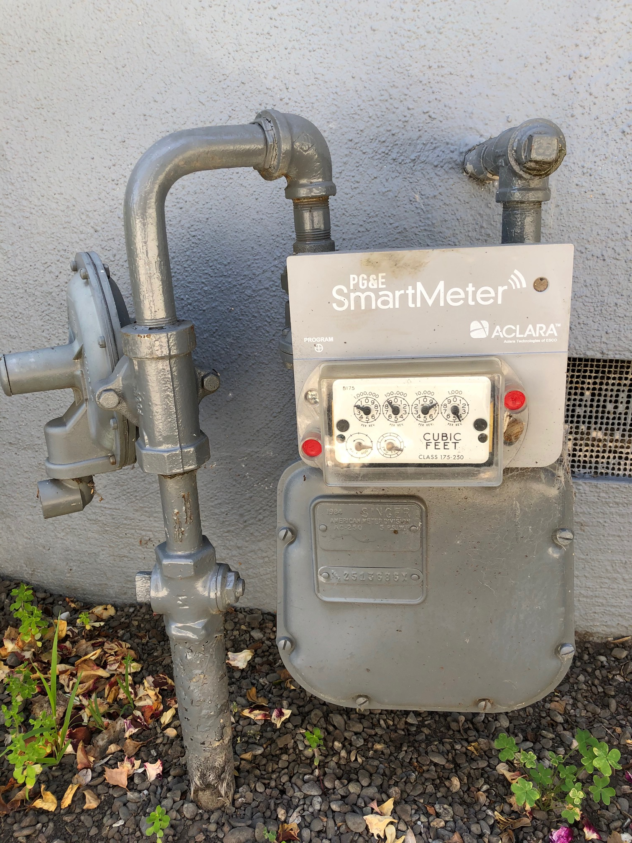
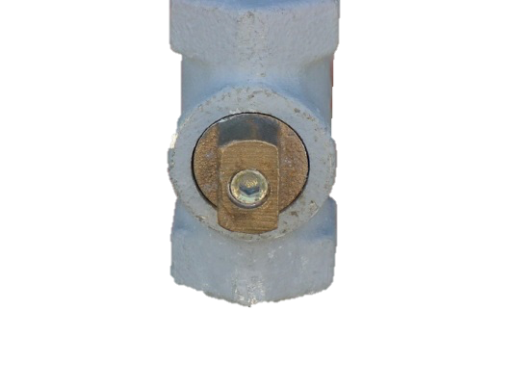
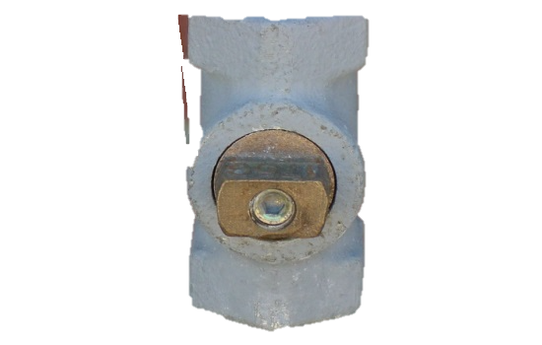
Gas Shutoff
Locate and label gas shutoff valves
If not automatic, know procedures for shutting off gas
PM 6-16
CERT Basic Training Unit 6: Fire Safety and Utility Controls
6-20

Slide 24
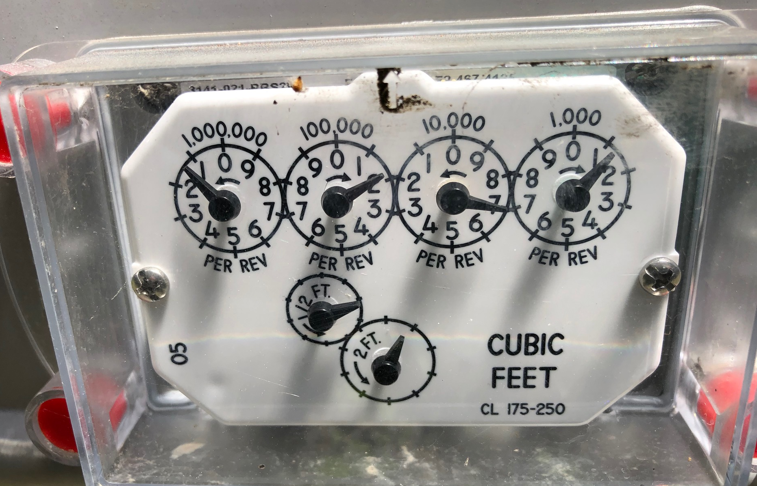
When to Shut Gas Off
When odor or sound of gas is detected
Building has major structural damage or fire
Gas meter wheels are turning rapidly (look at smallest)
Never turn back on yourself!
CERT Basic Training Unit 6: Fire Safety and Utility Controls
6-20

Slide 25
Hazardous Materials
Corrode other materials
Explode or are easily ignited
React strongly with water
Are unstable when exposed to heat or shock
Are otherwise toxic to humans, animals, or the environment through absorption, inhalation, injection, or ingestion
PM 6-18
CERT Basic Training Unit 6: Fire Safety and Utility Controls
6-22

Slide 26
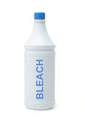
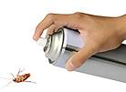
Hazardous Materials
HazMat are many types and everywhere
  Kitchen
  Garage
  Bathroom
  Patio
CERT Basic Training Unit 6: Fire Safety and Utility Controls
6-22

Slide 27
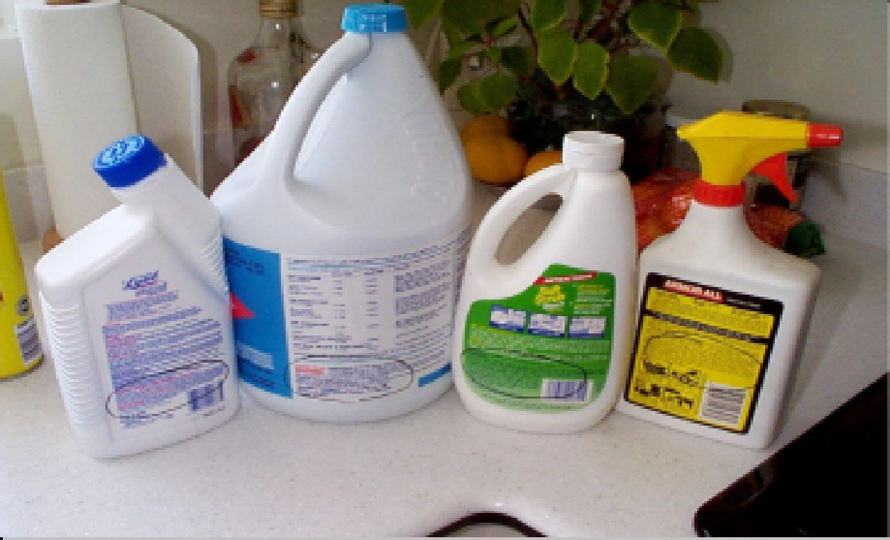
L.I.E.S.
Always read labels
Use L.I.E.S. storage procedures
  Limit,
  Isolate,
  Eliminate,
  Separate
PM 6-17
CERT Basic Training Unit 6: Fire Safety and Utility Controls
6-21

Slide 28
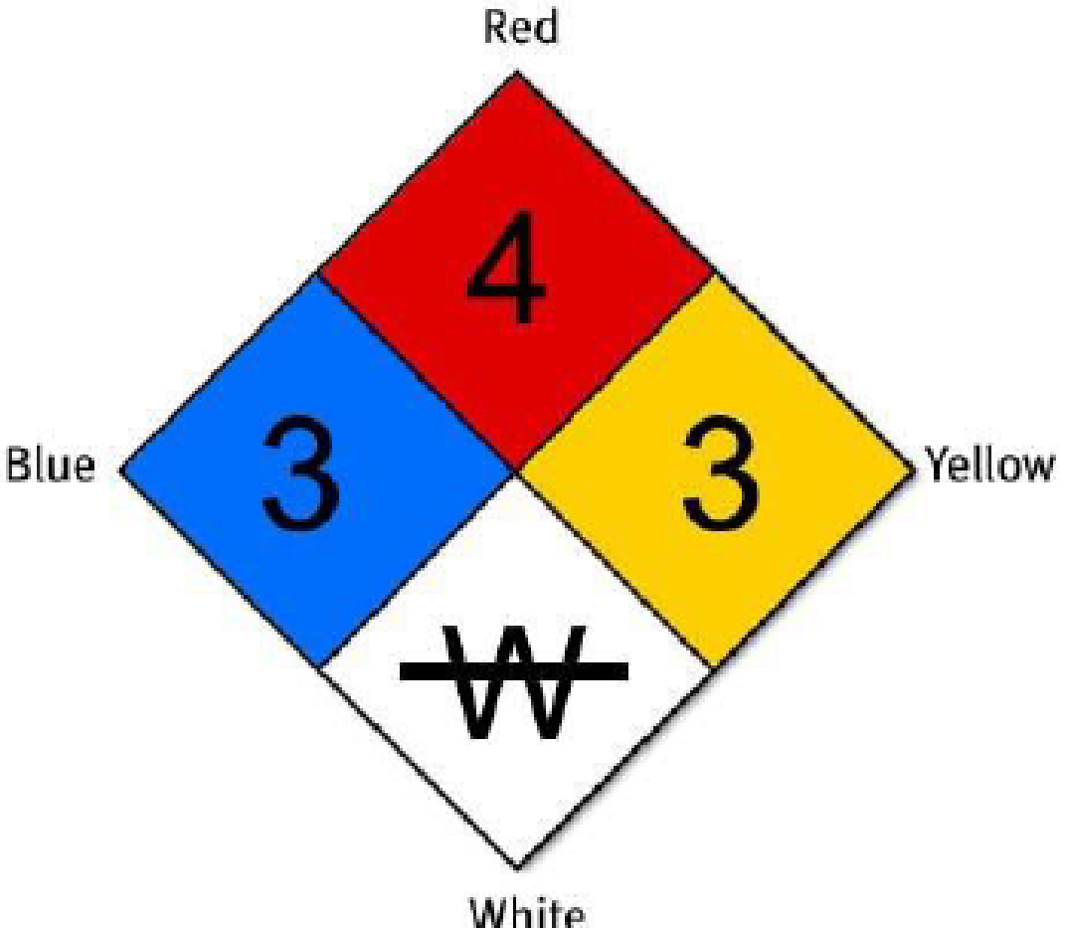
Identifying Stored Hazardous Materials
PM 6-19
CERT Basic Training Unit 6: Fire Safety and Utility Controls
6-23

Slide 29
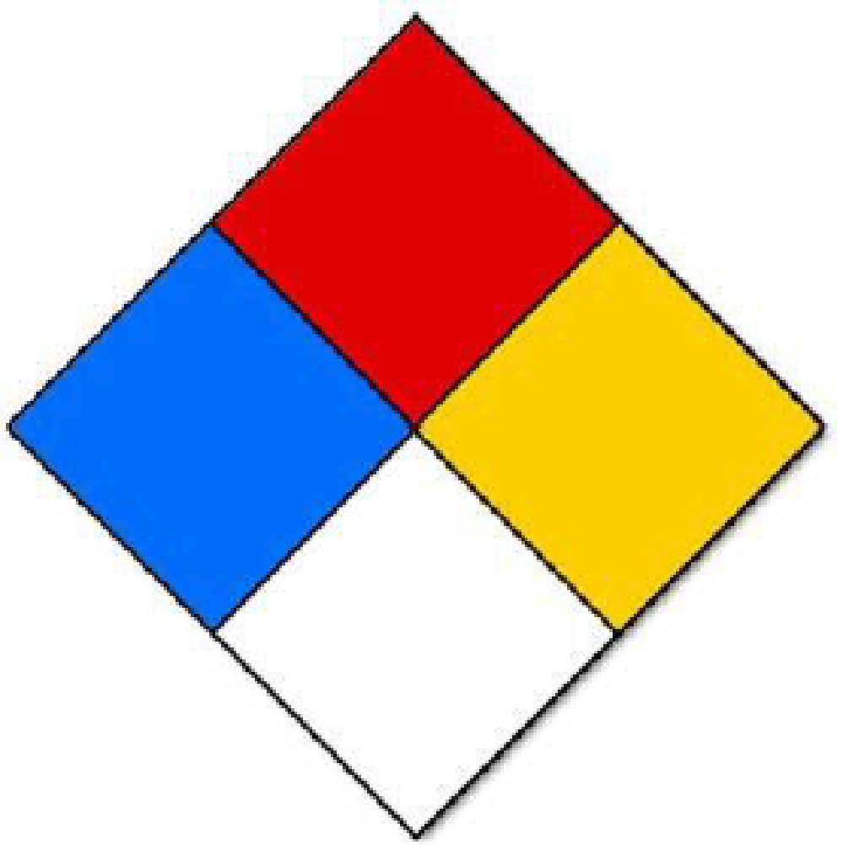
The White Quadrant
NFPA 704 Diamond White Quadrant:
  W: Shows unusual reactivity with water
  OX: Possesses oxidizing properties
PM 6-19
CERT Basic Training Unit 6: Fire Safety and Utility Controls
6-24

Slide 30

Greater Than 1?
Remember:
All hazardous material placards are a stop sign for CERT volunteers!
CERT Basic Training Unit 6: Fire Safety and Utility Controls
6-25
Notes:
If the numbers on the sign are greater than one, that tells you we are to keep away. STOP!

Slide 31
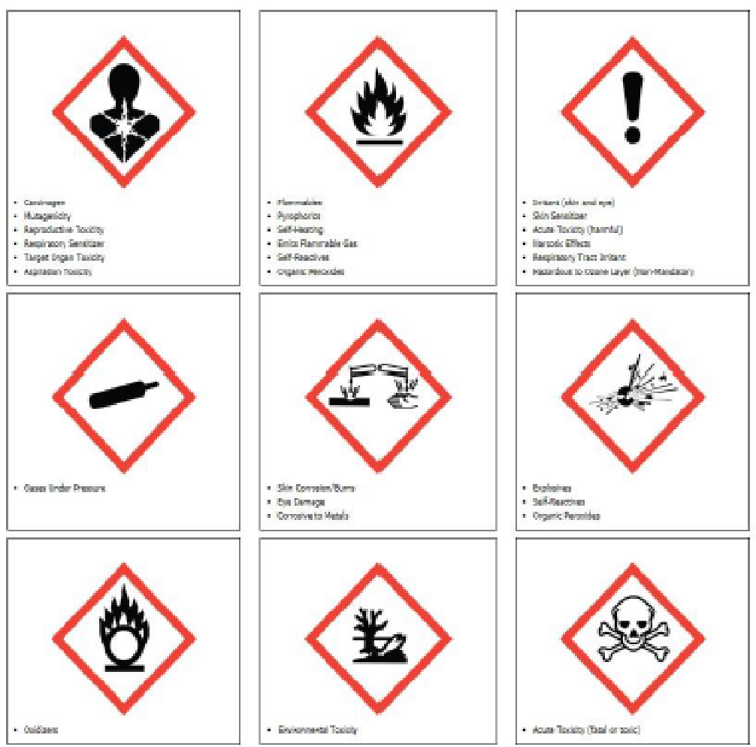
Global Harmonized System
PM 6-20
CERT Basic Training Unit 6: Fire Safety and Utility Controls
6-26

Slide 32
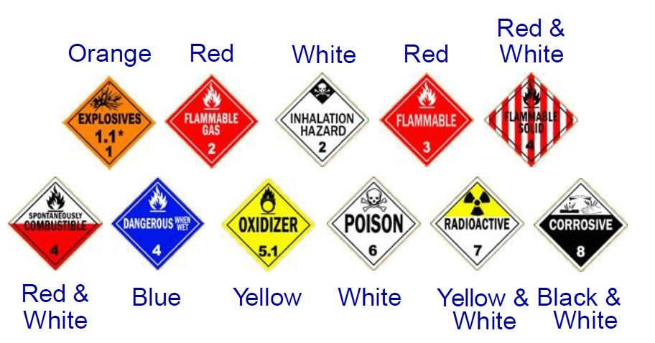
HazMats in Transit
PM 6-21
CERT Basic Training Unit 6: Fire Safety and Utility Controls
6-27

Slide 33
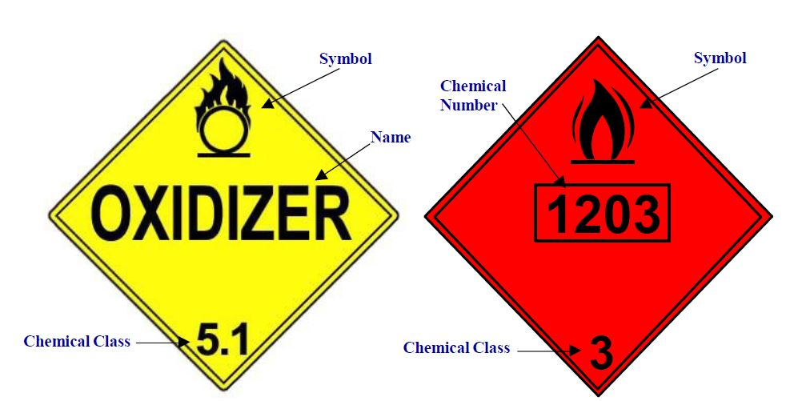
UN and NA Placards
PM 6-21
CERT Basic Training Unit 6: Fire Safety and Utility Controls
6-28

Slide 34

Greater Than 1?
Remember:
All hazardous material placards are a stop sign for CERT volunteers!
CERT Basic Training Unit 6: Fire Safety and Utility Controls
6-29

Slide 35
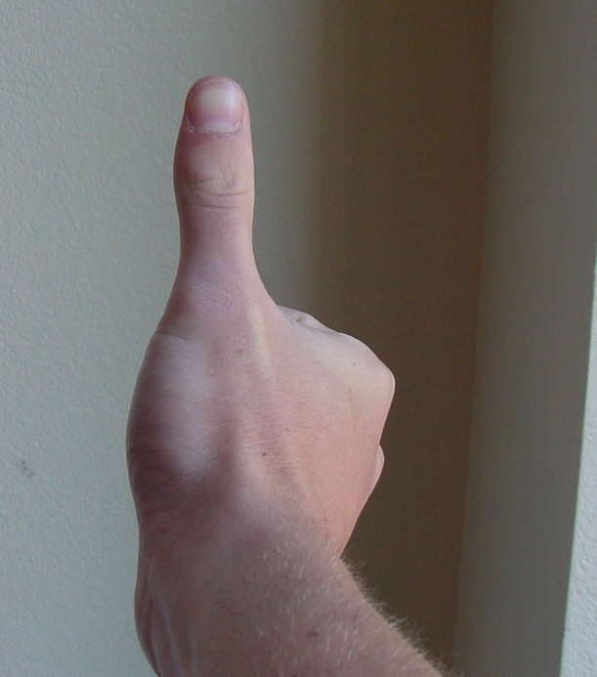
Haz Mat Rule of Thumb
If the hazard area looks bigger than your thumb, you are
TOO CLOSE!
Do NOT enter building or area even if victims are there
Stay uphill and upwind
Isolate, warn and deny entry
Evacuate downwind area, if needed
Notify Team Leader and Incident Command
CERT Basic Training Unit 6: Fire Safety and Utility Controls
6-30

Slide 36
Unit Summary (Unit 6)
You should know:
  Keys to effective fire suppression
  CERT safety and size-up
  Classes of fire and types of fire extinguishers
  Utility controls
  P.A.S.S. and L.I.E.S.
  How to identify hazardous materials
  Always have a buddy.
  Personal safety comes first!
PM 6-23
CERT Basic Training Unit 6: Fire Safety and Utility Controls
6-31

Slide 37
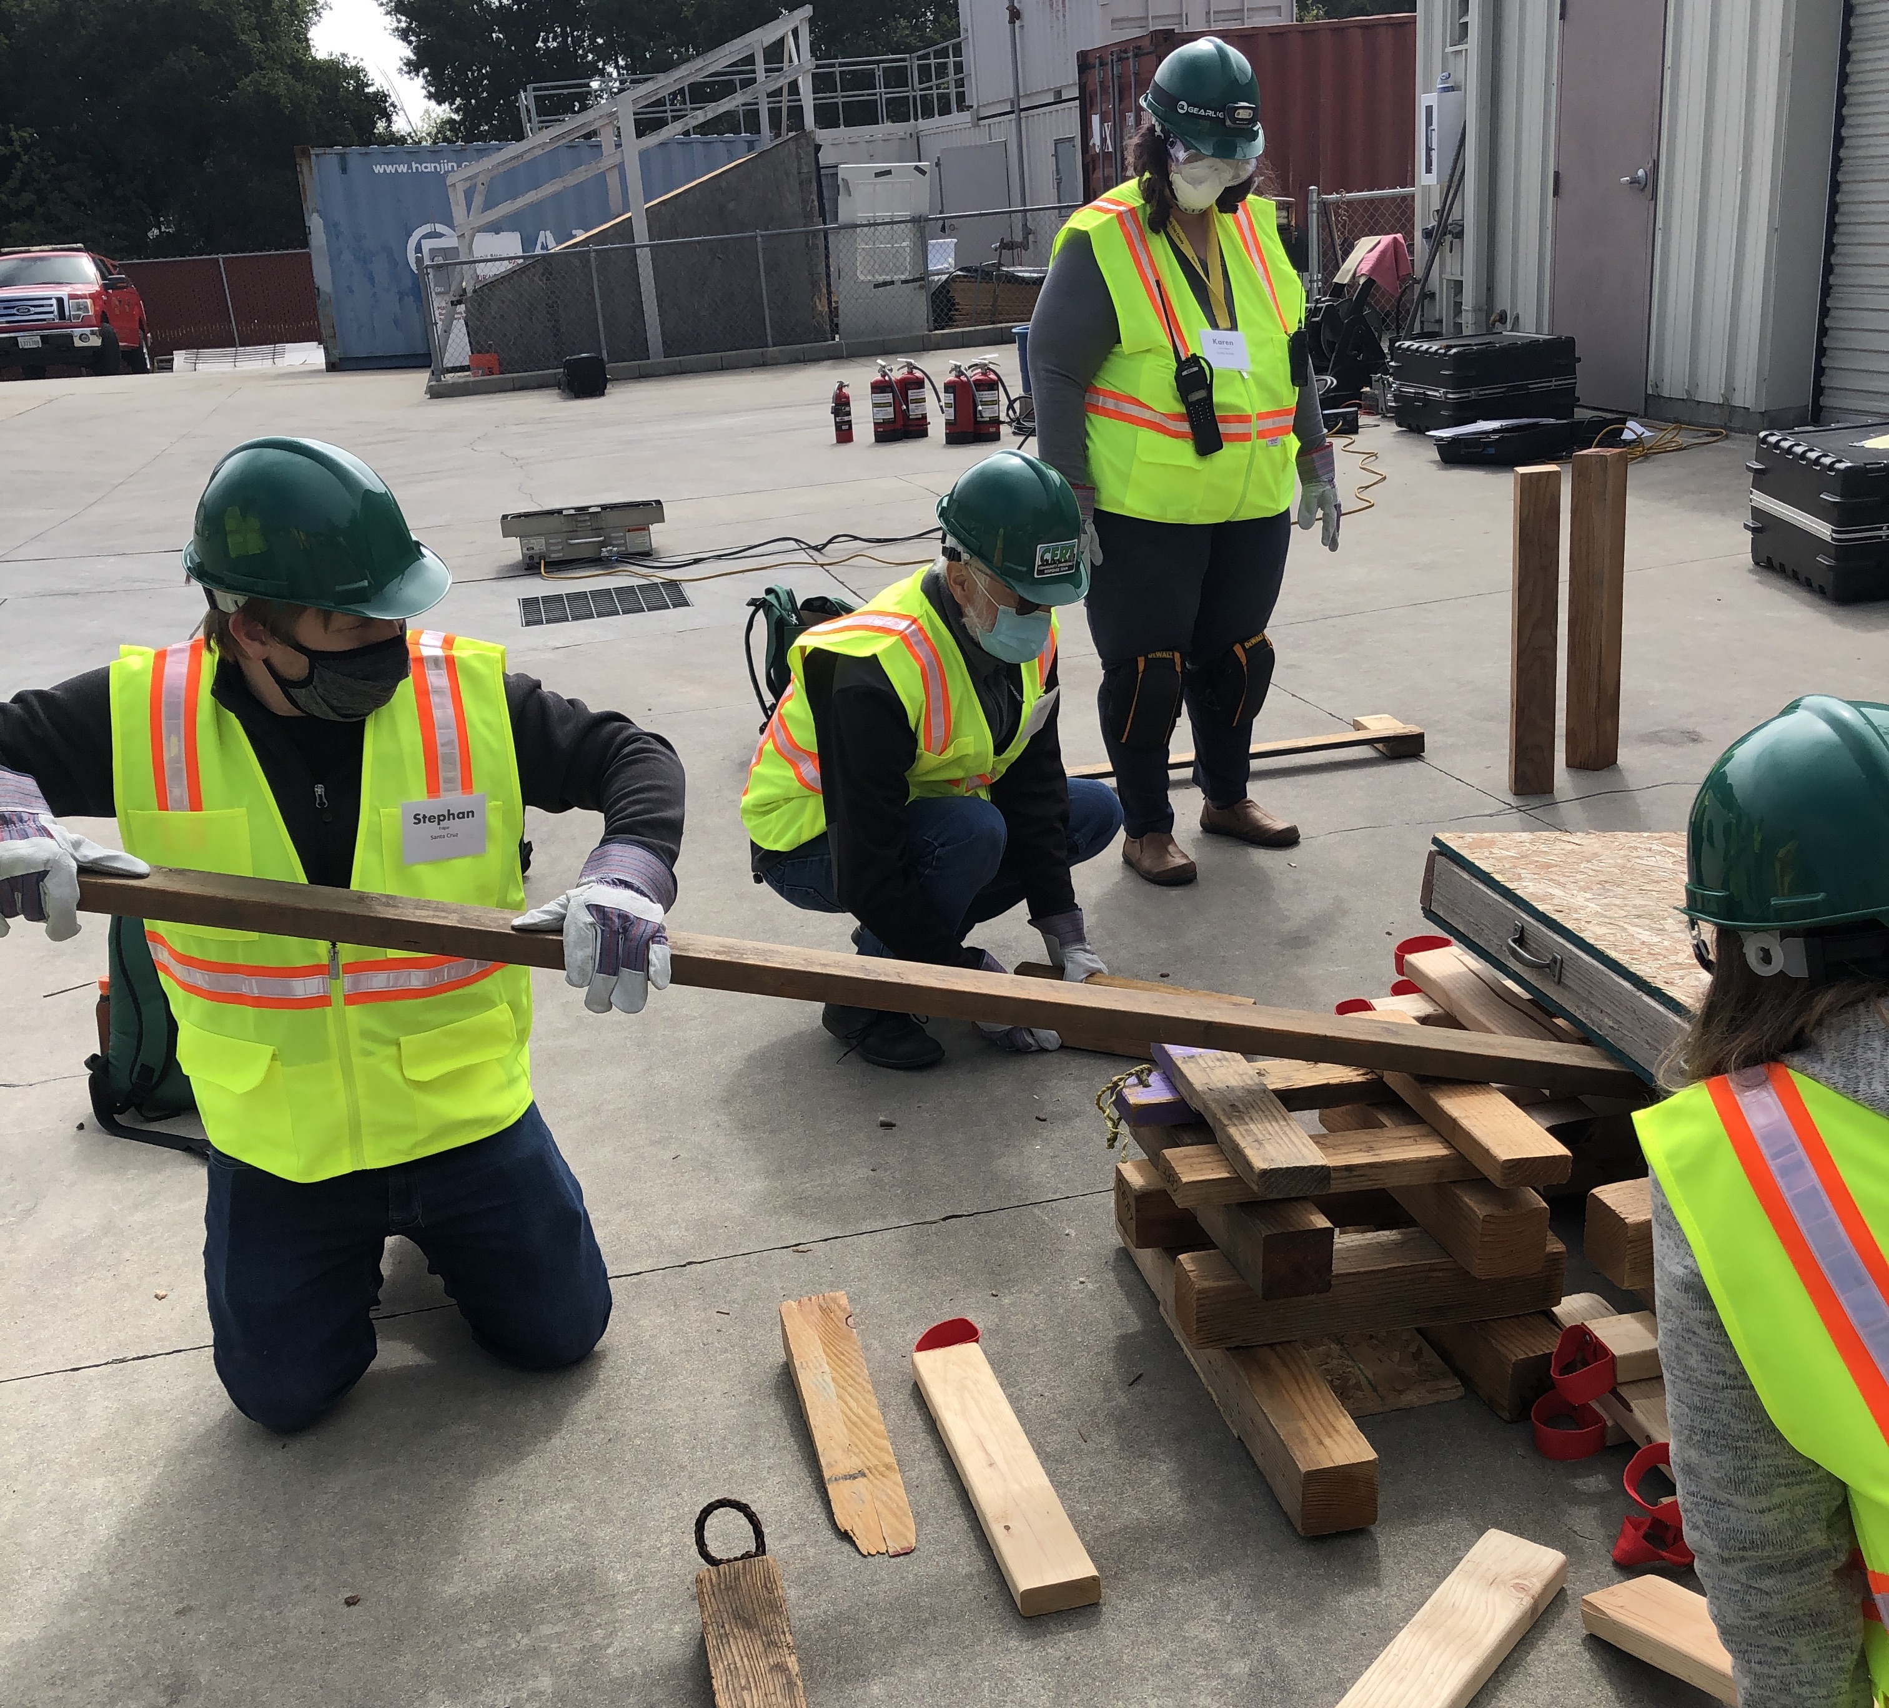
Homework Assignment (Unit 6)
Read unit 7 to be covered in next session
Wear appropriate clothes to next session
  Long pants & long sleeves
  Closed-toe shoes
  Weather appropriate attire for outside activities
Be here at 8:30 am!
Location is ___________
CERT Basic Training Unit 6: Fire Safety and Utility Controls
6-32

